Slide 1
Design Thinking for Policy Evaluation: The Policy Trial Emulation Framework
Ncsu Department of statistics seminar
Nicholas J. Seewald, Ph.D.
Assistant Professor of Biostatistics
April 4, 2025

Slide 2
Some Framing
Scan for slides
In statistics, we’re often taught with statements that begin with
“Given data $X$…”
But getting data $X$ is often very hard!
The goal of this talk is to get you thinking very deeply about design.

Slide 3
The Goal of Policy Evaluation
Scan for slides
In general:
“What is the effect of [a policy] on [outcome(s) of interest] over [a defined period of time], relative to what would have happened in the absence of the policy?”
Design thinking is useful in operationalizing this question.

Slide 4
Challenges of Policy Evaluation
Scan for slides
Can be difficult to isolate policy of interest
“Current events are happening as we speak.” - Matt Rogers, Las Culturistas
Confounding by time
Heterogeneous policies
Small sample size

Slide 5
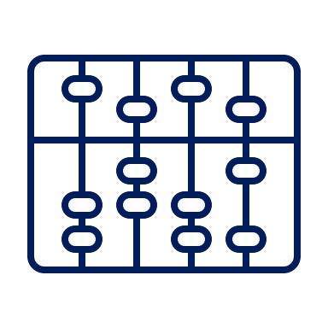
Some More Framing
Researchers often start with a data structure and let everything flow out of that. That is… not great!
Population
Scientific Question
Data Structure
Method

Slide 6
Some More Framing
We should be using the question to inform decisions, with the data structure used to guide practical realities.
Population
Data Structure
Scientific Question
Method

Slide 7
Designing for Policy Evaluation
High-quality study design helps alleviate concerns about
Isolating the policy of interest
Confounding by time
Heterogeneous policies
“Mixed-methods” approaches allow better understanding of
“Treatment” definition
Implementation time
Effects (or lack thereof)

Slide 8
Target Trial Emulation (TTE)
A design framework for thinking about non-experimental studies that enables stronger designs and facilitates causal inference.
Key Idea: Think about the trial you would run if you could, then design a non-experimental analogue that gets as close as possible.
Common in epidemiology, but broadly applicable
Not magic! TTE per se does not guarantee quality.
doi.org/nmmw

Slide 9
Controversy! Gasp!
Health policy applications often require different considerations than studies of individual-level interventions.
Policies are cluster-level interventions
Policy evaluations require natural experiments
Sample sizes are often small
Policy-level units are not exchangeable (e.g., states)
The practical reality of policy evaluation requires trade-offs from ideal trial emulation best practices.

Slide 10
Components of Policy Trial Emulation
Units and eligibility criteria
Definitions of exposure and comparison conditions
Assignment mechanism
Baseline / time zero and follow-up
Outcomes
Causal estimand
Statistical analysis and assumptions
This all happens before analysis!

Slide 11
1. Units & Eligibility
Who are we studying?

Slide 12
Units and Eligibility Criteria
Policy evaluations must consider
“Policy-level” units that could implement the policy or comparison condition
“Impact-level” units that the policy is designed to affect and on which outcomes are measured.
If policy- and impact-level units are different, policy evaluations would emulate cluster-randomized trials.
Policy-Level Unit
Impact-Level Unit
Impact-Level Unit
Impact-Level Unit

Slide 13
Units and Eligibility Criteria
Policy evaluations must consider
“Policy-level” units that could implement the policy or comparison condition
“Impact-level” units that the policy is designed to affect and on which outcomes are measured.
If policy- and impact-level units are different, policy evaluations would emulate cluster-randomized trials.
Policy-Level Unit
Impact-Level Unit
Notes:
As an example here, consider

Slide 14
Policy-Level Units
Hypothetical Policy Trial
Units that could implement the policy (states, organizations, etc.)
Monitored longitudinally
Eligibility criteria would be based only on pre-policy information:
“has not implemented the policy before” or more complex (e.g., “has not previously implemented policies X, Y, Z”)
Policy Trial Emulation
Units that did implement the policy or did implement the comparison condition
Monitored longitudinally
Eligibility criteria should be based only on pre-policy information:
“has not implemented the policy before” or more complex (e.g., “has not previously implemented policies X, Y, Z”)

Slide 15
Impact-Level Units
Hypothetical Policy Trial
Units that the policy is designed to affect.
the policy-level units themselves, or
sub-units nested in policy-level units on which outcomes are measured, ideally from the population the policy is designed to affect.
Eligibility based only on pre-policy information:
“Lives in state X” for policies that apply to everyone
“Lives in state X and was diagnosed with Y before the policy”, etc.
Retention efforts if followed longitudinally
Policy Trial Emulation
Same deal!

Slide 16
Example: Medical Cannabis Laws
Consider a study designed to understand the effects of state medical cannabis laws on opioid prescribing among individuals with chronic non-cancer pain.
Policy-level units:
States that did or did not implement a medical cannabis law, 2014-2019
Impact-level units:
Individuals living in a policy-level unit with a chronic non-cancer pain diagnosis in the 3 years prior to “time zero”
doi.org/khxp

Slide 17
Available Data Affects Emulation Quality
“Group panel” data aggregated to policy level is common
Might not be possible to restrict to target population ($→$ weaker study)
Okay if aggregated from target population (e.g., all individuals with SMI) or if target population is very general
Impact-level data enables additional eligibility criteria
Can restrict to target population ($→$ stronger study)
(Probably) doesn’t improve efficiency for continuous outcomes

Slide 18
Longitudinal Follow-Up of Impact-Level Units
In policy trial emulation, following impact-level units longitudinally vs. in repeated cross-sections changes the sampling frame.
“Continuous presence” requirement can mimic high-quality retention efforts in an RCT
Maybe inappropriate if exposure affects probability of continuous presence
Not requiring this probably leads to missing service use and allows patient case-mix to change over time
Threatens internal validity but improves external validity (weighting can help!)
Impacts generalizability

Slide 19
2. Exposure & Comparison Conditions
What are we studying?

Slide 20
Definitions of Exposure & Comparison Conditions
Hypothetical Target Trial
Policy Trial Emulation Analogue
Exposure would be one policy that all implementing units are assigned to implement.
Comparison could be a specific alternative policy, or “business as usual”
Specific details of each policy can be quite heterogeneous
E.g., specialty mental health clinics implement cardiovascular care management to different extents or in different ways.

Slide 21
Defining the Exposure
Legal epidemiology
Use qualitative methods to identify a class (or small number of classes) of similar policies that will be the exposure(s).
Definition should be precise to help disentangle effects of interest & avoid confounding policies.
Could emulate a multi-arm trial.

Slide 22
Defining the Comparison Group
Best practices for trial emulation:
At time zero, the comparison group is every policy-level unit that has not been exposed at that time
If unexposed units become exposed later, censor their outcomes when they become exposed.
This ideal design isn’t always practical for policy evaluations.

Slide 23
Choosing Comparators for Policy Evaluation
Unexposed at Baseline
Never Exposed
Avoids conditioning on post-treatment information
Allows the comparison group to change (possibly meaningfully) over time.
Is an observed effect due to the policy or the changing comparison group?
Chosen using knowledge of future policy status – could lead to bias!
Clearly not ideal in the target trial framework, but
the comparison group remains unchanged over time.

Slide 24
Never-Exposed Comparators
Very commonly used in policy evaluations, but
Studies that choose to use never-exposed comparators are subject to additional assumptions about the comparability of ever- and never-exposed units and are subject to bias.
This choice deviates from ideal target trial emulation.
Options for redesigning the study:
Change policy-level eligibility criteria to de facto exclude likely bad comparators (geography, urbanicity, etc.). Pay attention to remaining sample size!
Limit the follow-up period to one in which good comparators exist.

Slide 25
Example: Medical Cannabis Laws
Our exposure was
Implementation of a medical cannabis law that allowed qualified patients to purchase cannabis at a dispensary, and
Lack of implementation of a recreational cannabis law.
The comparison condition was
Lack of implementation of a medical cannabis law, 2010-2022.
(i.e., never-exposed comparators)

Slide 26
3. Assignment Mechanism
How did units decide to implement or not implement the policy?

Slide 27
Assignment Mechanism
Hypothetical Target Trial
Policy Trial Emulation Analogue
Cluster-randomized
Possibly stratified
Almost certainly unblinded
Unconfounded
Not randomized
(Usually) emulates cluster randomization
Almost certainly unblinded
Affected by known and unknown characteristics of policy-level units

Slide 28
4. Baseline / Time Zero
When did units decide to implement or not implement the policy?

Slide 29
Baseline / Time Zero
Hypothetical Target Trial
Policy Trial Emulation Analogue
Time of randomization
Recruitment & prep done prior, so policy can be implemented immediately
When the policy could start impacting outcomes
Complicated for comparison units. When could they have implemented the policy but did not?

Slide 30
Baseline / Time zero
A bad definition can lead to bias (conditioning on post-treatment information)
“Staggered adoption” yields even more complexity. One solution is serial trial emulation:
Define baseline for each treated unit, then use those calendar times to define a series of baselines for comparators
Creates multiple trial emulations, one per unique policy implementation date

Slide 31
Serial Trial Emulation

Slide 32
5. Outcomes and Follow-Up
What are we measuring and when?

Slide 33
Outcomes
Outcomes are interpreted at the policy level: they’ll be proportions, means, etc. for each policy-level unit.
Natural for group-panel data!
Individual-level data will be aggregated to the policy level
Can be prospectively designed in an RCT, but non-experimental policy evaluations are retrospective by nature.

Slide 34
Follow-Up
RCTs typically have one (or few) pre-exposure measurements.
Validity of causal estimate in non-experimental study often relies on reasonably large number of pre-treatment measurement occasions.
Post-exposure follow-up should capture meaningful effects & changes therein.

Slide 35
6. Causal Estimand
What population-level quantity describes the question of interest?

Slide 36
Causal Estimand
Often, a causal quantity that describes the average difference between counterfactual outcomes in policy-level units under exposure and comparison conditions.
Answers questions about what would have happened under different states of the world.
Expressed in potential outcomes notation:
$Y\left(1\right)$ is the outcome that would be observed under exposure
$Y(0)$ is the outcome that would be observed under no exposure

Slide 37
Categories of Causal Estimand
Typically the target (by convention)
Average treatment effect (ATE) compares expected counterfactual outcomes under exposure to those under the comparison condition on average over the entire population
$E\left[Y\left(1\right)−Y(0)\right]$
Average treatment effect among the treated (ATT) compares observed outcomes in the exposed group to what would have happened had they been unexposed:
$E\left[Y\left(1\right)−Y\left(0\right)∣A=1\right]$
Average treatment effect among comparators (ATC) compares observed outcomes in the unexposed group to what would have happened had they been exposed:
$E\left[Y\left(1\right)−Y\left(0\right)∣A=0\right]$

Slide 38
Target Estimands & Target Audiences
Policymakers (hopefully) want to know what will happen if they implement something
Question of interest for PA probably isn’t “What happened in MD”, but “What will happen in PA?”
(⬆️ That’s not an ATT!)

Slide 39
We all love the ATT
The average treatment effect among the treated (ATT) compares what actually happened to the policy-implementing units to what would have happened in the absence of the policy.
$$ATT=E\left[Y\left(1\right)−Y\left(0\right)\right|A=1]$$
A ton of methods estimate this.
But there are inherent limitations here!

Slide 40
Pros and Cons of the ATT
$$ATT=E\left[Y\left(1\right)−Y\left(0\right)\right|A=1]$$
The ATT is nice because it
is common, and so easy to communicate
only requires imputing one counterfactual
neatly describes what happened
One big problem, though:
The ATT doesn’t necessarily give actionable information to policymakers: it’s inherently post hoc

Slide 41
Why do we prefer the ATT?
The ATE and ATC both require estimating $E[Y\left(1\right)∣A=0]$
This… feels weird! Usual identification assumptions often feel too strong.
But: mismatch between the real question and what we can confidently do
We should try to get creative here!

Slide 42
7. Statistical Analysis
How do we analyze data to answer the question, and under what assumptions?

Slide 43
Analytic Considerations
The hypothetical cluster-randomized target trial can use “standard” tools
Our non-experimental trial analogue probably can’t, because assignment is confounded.
Goal: Estimate the estimand with reasonable assumptions.
Methods usually use pre-baseline information from exposed & comparison units to extrapolate an estimate of the exposed group’s counterfactual outcomes under no policy.

Slide 44
Methods Explosion!
There’s an increasingly large class of methods designed for this setting!
Difference-in-differences
Two-way fixed effects
Synthetic controls
Augmented synthetic controls
Event studies
Different methods rely on different assumptions: be careful to be reasonable!

Slide 45
Difference in Differences (DiD)
Big Idea: Compare change in outcome over time between exposed and comparison groups.
Key Assumption: ”Parallel counterfactual trends”
The exposed group’s outcome evolution would have looked like the comparison group’s outcome evolution had the exposed group not been exposed.

Slide 46
Staggered Adoption
Not every exposed unit is exposed at the same time!
Staggered program rollout
Policies adopted at different times
This can create big problems with traditional estimation.
Traditional approach can be extremely biased if there are time-varying treatment effects under staggered adoption. (Goodman-Bacon 2021)
AZ, CT
AK, CO, DE
AL, PA
Goodman-Bacon A. Difference-in-differences with variation in treatment timing. J Econometrics. 2021 Dec;225(2):254–77.

Slide 47
New Methods Handle Staggered Adoption
One common solution:
Group units treated at the same time
Estimate “group-time” effects for each such group
Aggregate group-time effects to estimate quantities of interest
AZ, CT
AK, CO, DE
AL, PA
Callaway B, Sant’Anna PHC. Difference-in-Differences with multiple time periods. J Econometrics. 2021;225(2):200–30.

Slide 48
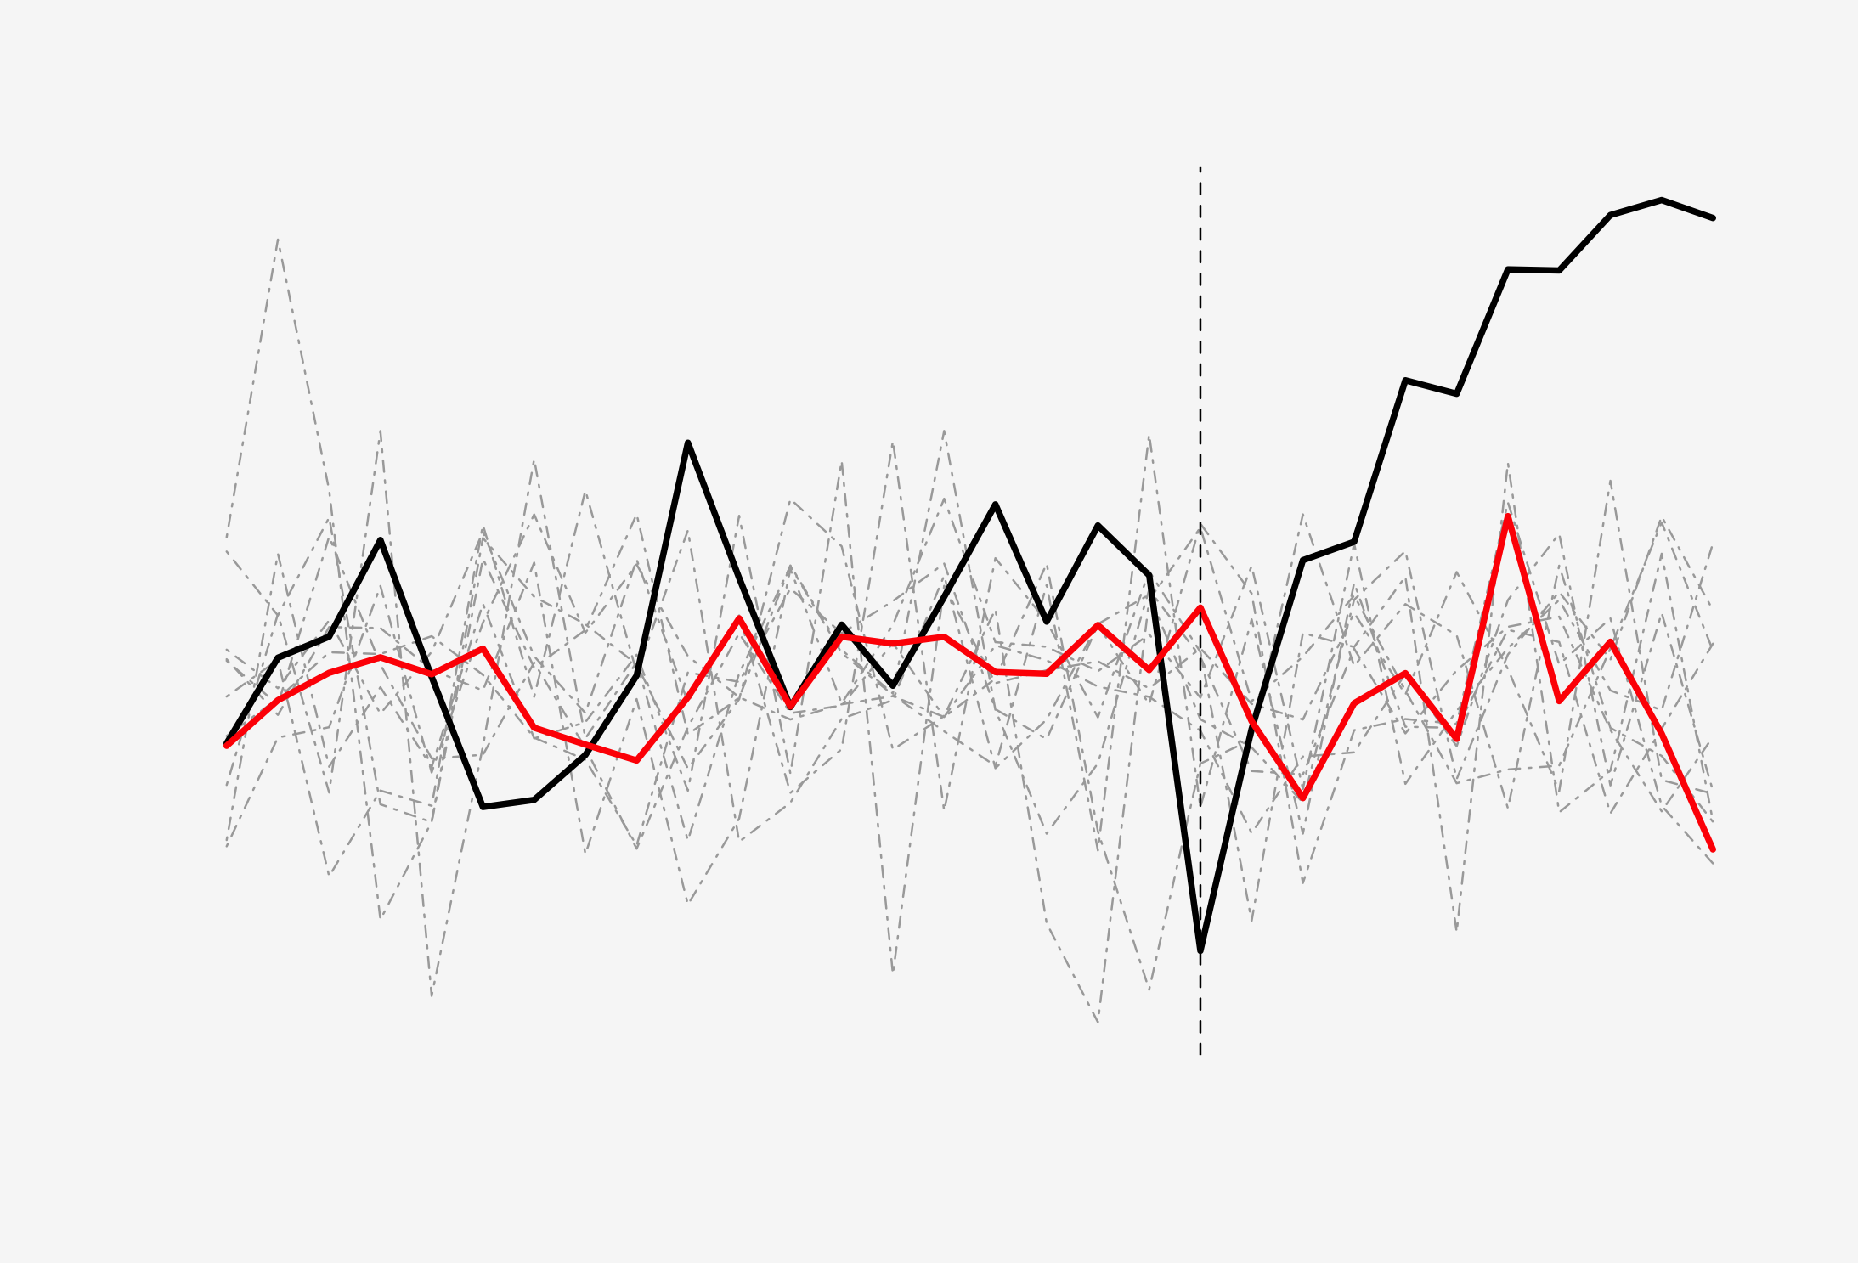
Synthetic Controls
Big Idea: Construct a weighted combination of non-implementing units that mimics the outcome trajectory of each implementing unit in the pre-policy period.
Then, extrapolate that combination forward to estimate the counterfactual for the exposed unit under no policy.
A useful variant is augmented synthetic controls, which incorporates covariates to get better pre-treatment fit.
Ben-Michael E, Feller A, Rothstein J. The Augmented Synthetic Control Method. J Am Stat Assoc 2021;116:1789–803.

Slide 49
Discussion

Slide 50
Good study design is critical
Scan for slides
Policy trial emulation provides a framework for thinking about good policy evaluation study design
Think about the trial you would run if you could, then try to get as close as possible.
Closer alignment between hypothetical target trial and non-experimental analogue improves communication
Clearly articulate similarities & differences across all 7 components
Use a table to compare target trial & emulation (Seewald, et al. 2024)
Helps readers understand design better & calibrate confidence in results
Seewald NJ, McGinty EE, Stuart EA. Target Trial Emulation for Evaluating Health Policy. Ann Intern Med 2024.

Slide 51
Good study design is not magic
Scan for slides
Policy trial emulation does not guarantee quality.
An emulated trial is not a trial.
Calling something “trial emulation” doesn’t mean the trial was emulated well.
There will always be trade-offs.

Slide 52
Statistical tools for high-quality policy evaluation are available and accessible
Lots of methods innovation across disciplines – join us!
The key goal is often to estimate a good proxy for what would have happened in the absence of the policy.

Slide 53
Multi-disciplinary work is key
Rigorous policy research requires collaboration across disciplines
Need both quantitative and qualitative approaches
Working across fields improves communication and impact
Challenging, but fun!

Slide 54
seewaldn@pennmedicine.upenn.edu
www.nickseewald.com

